Slide 1
BASE MECHANICS
-Inside/outside theory
-Force plays
-Tag plays
-Double plays

Slide 2
FORCE PLAYS
-45 degrees to base.
-Maintain depth (15 feet or so).
-Watch the infielder field the ball.
-Watch the throw/ball.
-Turn to the play after the throw.

Slide 3
FORCE PLAYS (CONT.)
-From foul ground (in A)?
-Positioning.
-Deviation/communication.
-Confidence in your partner.

Slide 4
TAG PLAYS
-90 degrees (ideally)to the path of the runner.
-Distance 10 to 12 feet.
-Adjust to throw, position of runner (and fielders).

Slide 5
DOUBLE PLAYS
-Movement toward 2nd base.
-One or two steps.
-Let the ball turn your head.
-Use “sell” call on second half when appropriate.

Slide 6
Set position for a safe call at 1st (mine)

Slide 7
Hands to chest

Slide 8
Arms extended (routine safe)

Slide 9
Step into play (sell safe)

Slide 10
Set position for an out call at first.

Slide 11
Hands to chest

Slide 12
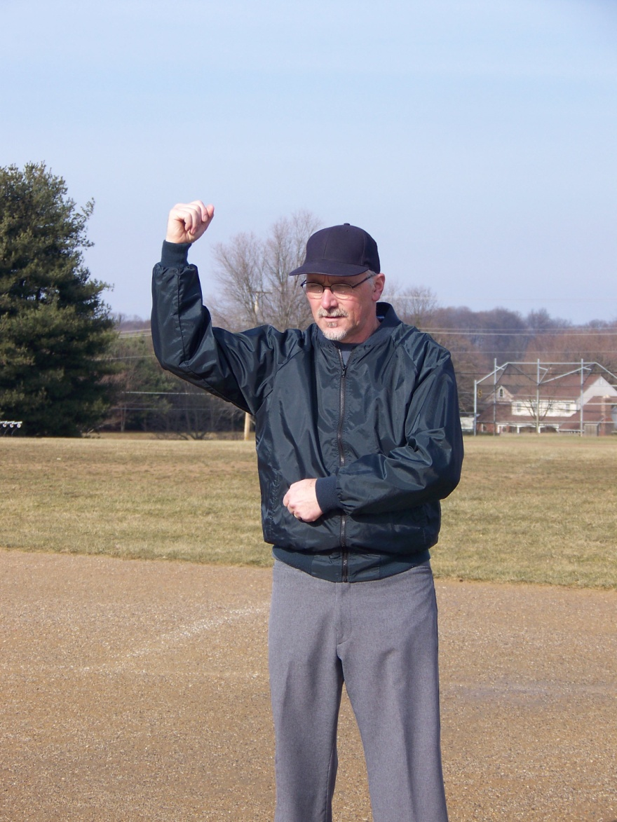
90 degree hammer (routine out)

Slide 13
Step into the play and throw the fist (sell out)

Slide 14
Obstruction (delayed dead ball)

